Slide 1
MODULE 12: HEAD INJURIES
TCCC TIER 1
All Service Members
TCCC TIER 2
Combat Lifesaver
TCCC TIER 3
Combat Medic/Corpsman
TCCC TIER 4
Combat Paramedic/Provider

Slide 2
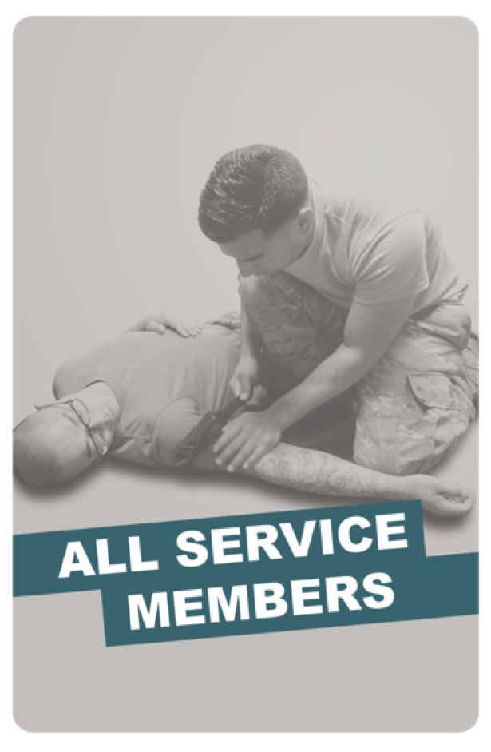
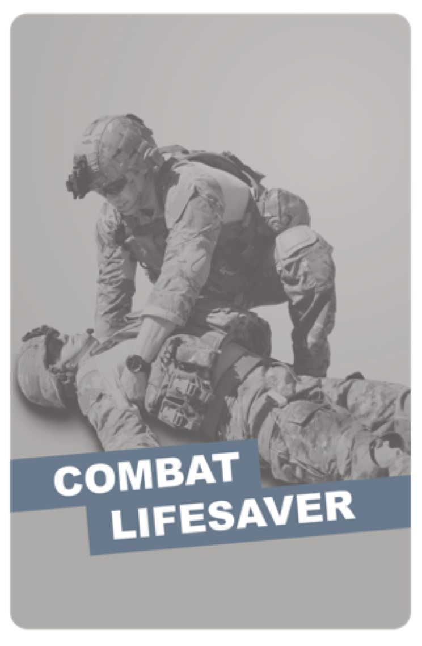
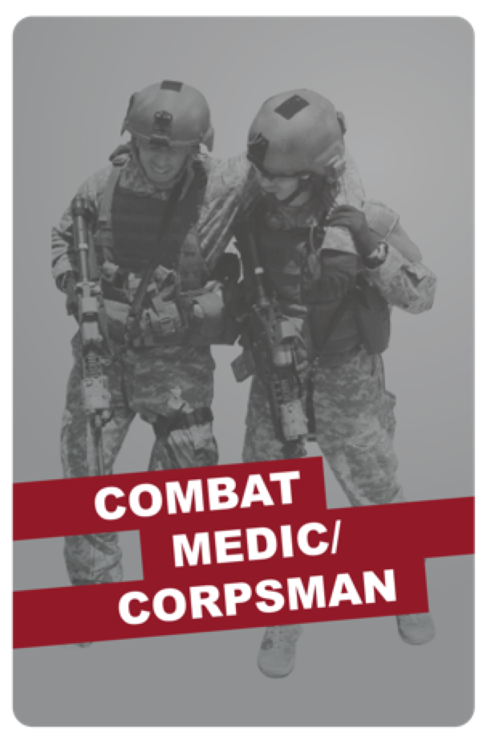
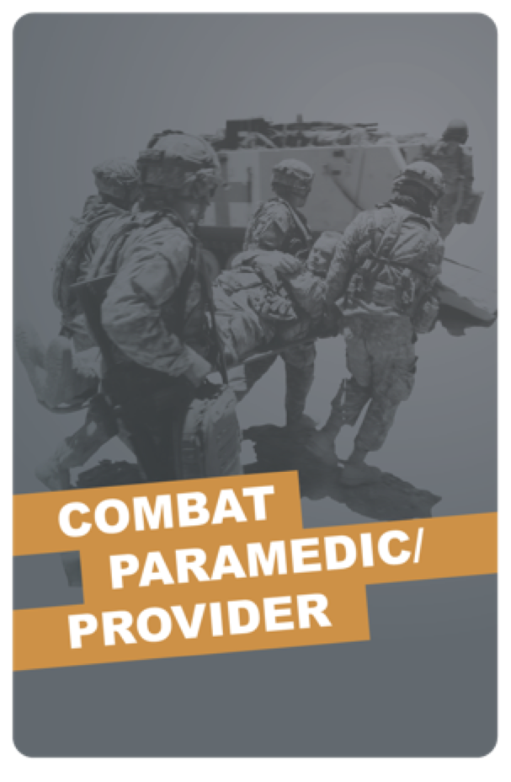
TACTICAL COMBAT CASUALTY CARE (TCCC) ROLE-BASED TRAINING SPECTRUM
ROLE 1 CARE
NONMEDICAL PERSONNEL
MEDICAL PERSONNEL
ASM
CMC
CPP
CLS
YOU ARE HERE
STANDARDIZED JOINT CURRICULUM

Slide 3




TERMINAL LEARNING OBJECTIVE
STUDENT LEARNING OBJECTIVES
13 Identify a head injury in accordance with DoDI 6490.11, Change 1. 1 June 2018
Identify external forces that can cause a head injury (DoDI 6490.11 enclosure 3 Section 1).
Identify signs and symptoms of a head injury (DoDI 6490.11, enclosure 3 Figure IED checklist).
Identify the critical observations that should be reported to medical personnel for trauma casualties with a suspected head injury, in accordance with the Military Acute Concussive Evaluation 2 (MACE 2).
3
ENABLING LEARNING OBJECTIVES (ELOs)
= Cognitive ELOs
= Performance ELOs

Slide 4


Three PHASES of TCCC
TACTICAL FIELD CARE
1 CARE UNDER FIRE
RETURN FIRE AND TAKE COVER
Quick decision-making:
▪ Consider scene safety
▪ Identify and control life- threatening bleeding
▪ Move casualty to safety
TACTICAL FIELD CARE
COVER AND CONCEALMENT
₃ TACTICAL EVACUATION CARE
More deliberate assessment and treatment of unrecognized
life-threatening injuries
▪ Pre-evacuation procedures
▪ Continuation of documentation
NOTE: This is covered in more advanced TCCC training!
2
Basic management plan:
Maintain tactical situational awareness
Triage casualties as required
Conduct MARCH PAWS
assessment
▪
▪
YOU ARE HERE
4
#TCCC-CLS-PPT-12 30 JUN 20

Slide 5
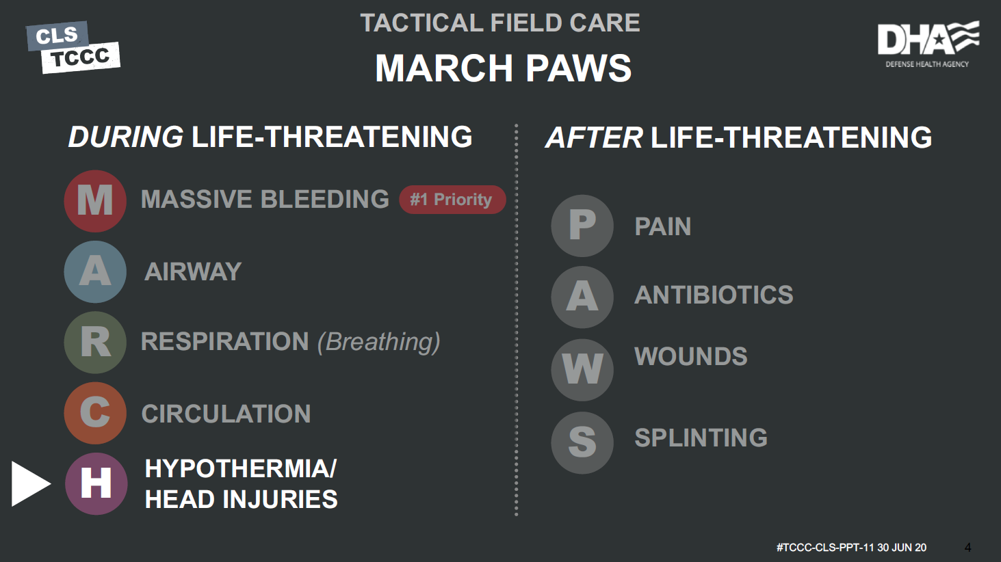
MARCH PAWS
TACTICAL FIELD CARE
DURING LIFE-THREATENING
AFTER LIFE-THREATENING
A R C
MASSIVE BLEEDING
P A W
S
#1 Priority
PAIN
AIRWAY
ANTIBIOTICS
RESPIRATION (breathing)
WOUNDS
CIRCULATION
SPLINTING
H
HYPOTHERMIA/ HEAD INJURIES
#TCCC-CLS-PPT-12 30 JUN 20

Slide 6
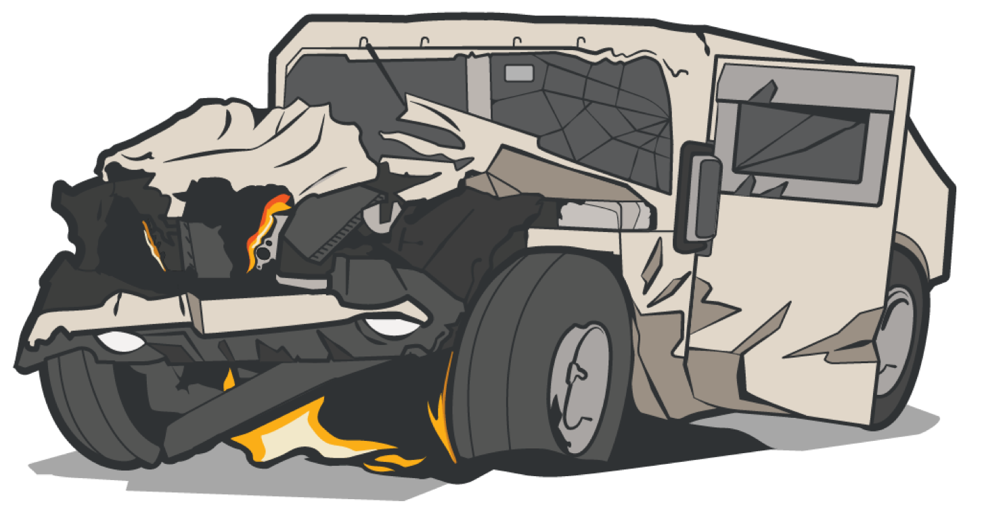
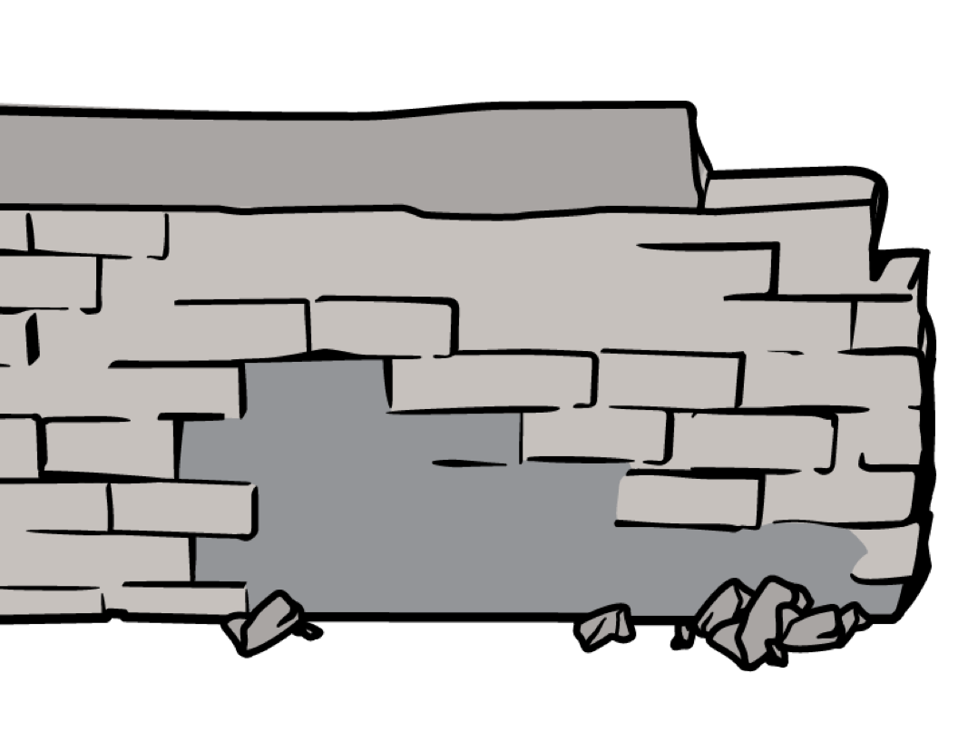
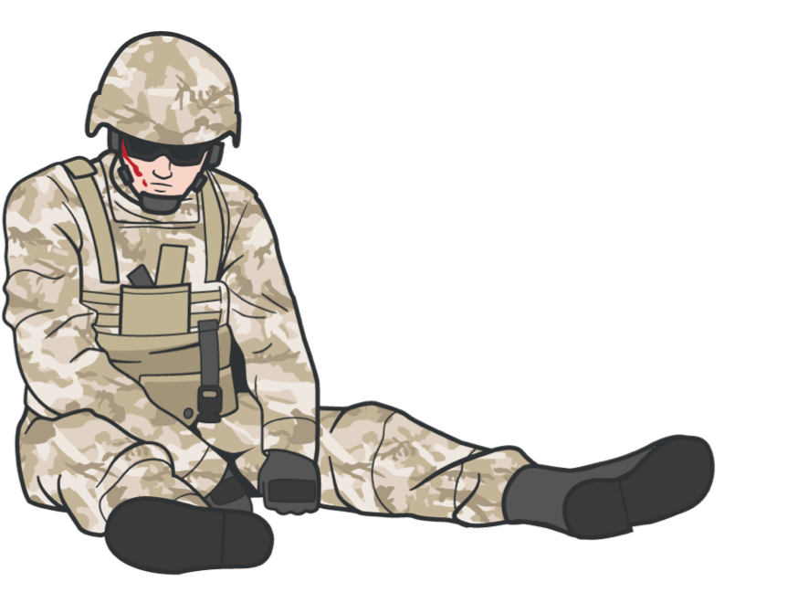

HEAD INJURIES
POTENTIAL MECHANISMS OF HEAD INJURY
Head injury is trauma to the scalp, skull, and/or brain
Involvement in a vehicle blast event, collision, or rollover
Presence within 50 METERS of a blast (inside or outside)
A direct blow to the head or witnessed loss of consciousness
Exposure to more than one blast event (the Service member’s commander will direct a medical evaluation)
OTHER EXTERNAL FORCES MAY ALSO LEAD TO HEAD INJURIES
#TCCC-CLS-PPT-12 30 JUN 20

Slide 7

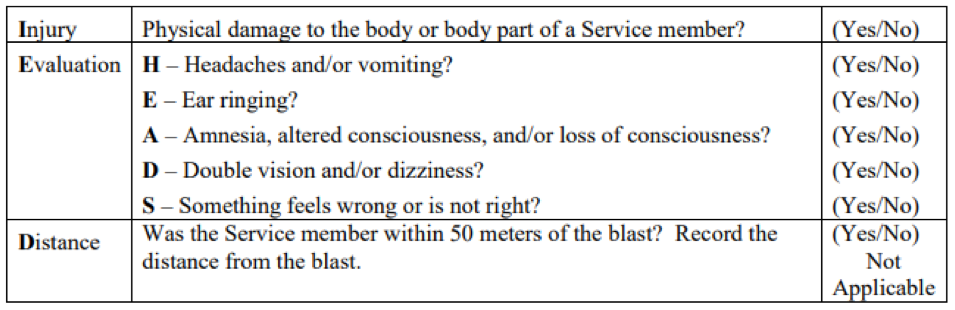
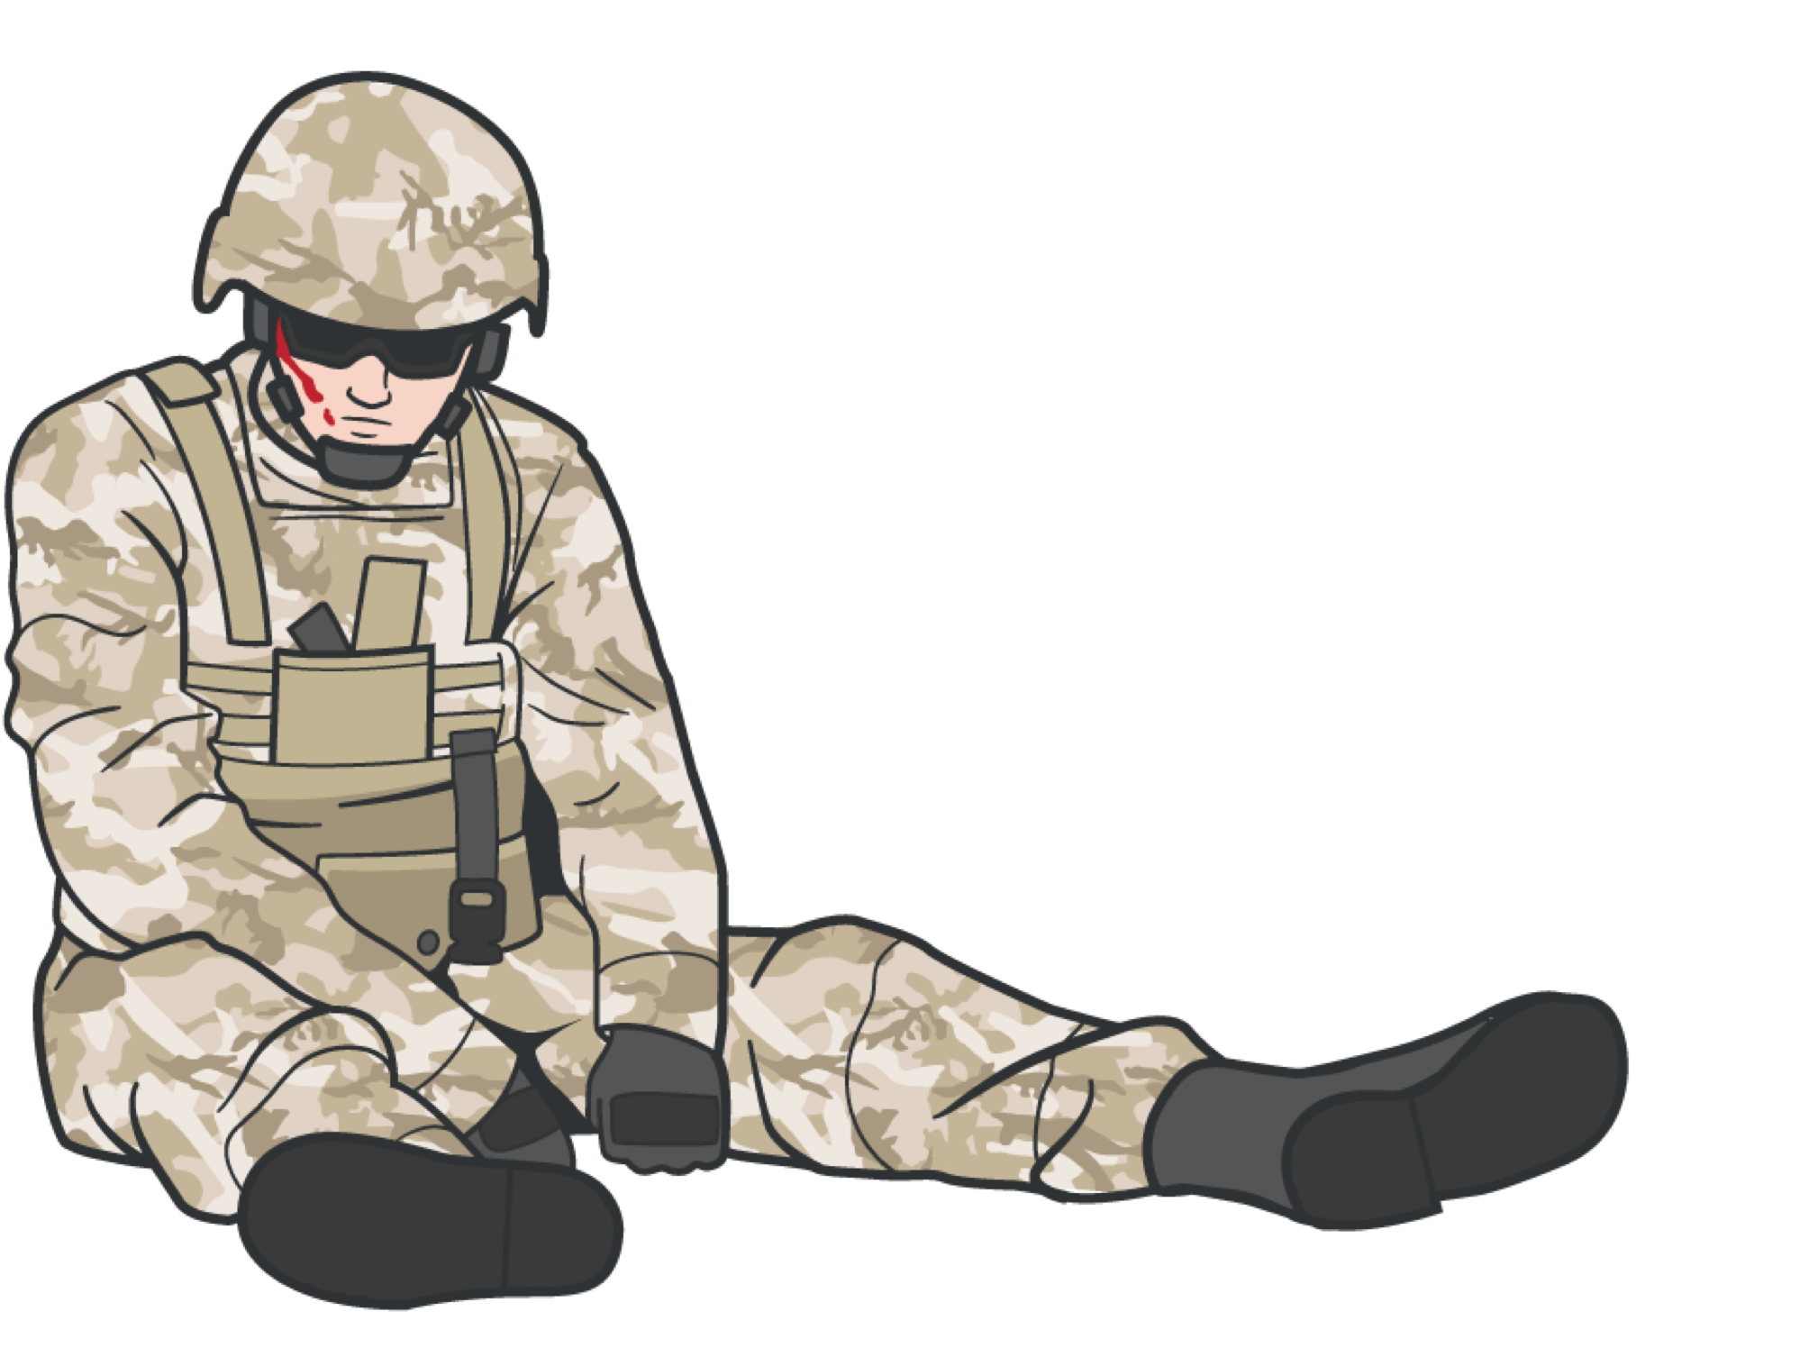
HEAD INJURIES
SIGNS AND SYMPTOMS OF HEAD INJURY
IED Checklist
DoDI 6490.11 (section 3, para 2.a)
#TCCC-CLS-PPT-12 30 JUN 20

Slide 8
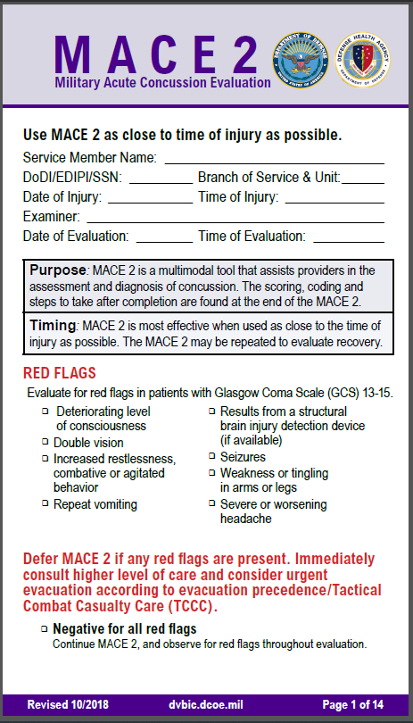
HEAD INJURIES
SIGNS AND SYMPTOMS REQUIRING MACE 2* EVALUATION BY MEDICAL PERSONNEL
Evaluations are most effective when done as soon as possible after the injury. Traumatic brain injury (TBI) is likely if the casualty shows signs of ANY of the following:
Deteriorating level of consciousness
Double vision
Increased restlessness; combative or agitated behavior
Repeat vomiting
Results from a structural brain injury detection device (if available)
Seizures
Weakness or tingling in arms or legs
Severe or worsening headache
*Military Acute Concussion Evaluation 2
#TCCC-CLS-PPT-12 30 JUN 20
8

Slide 9
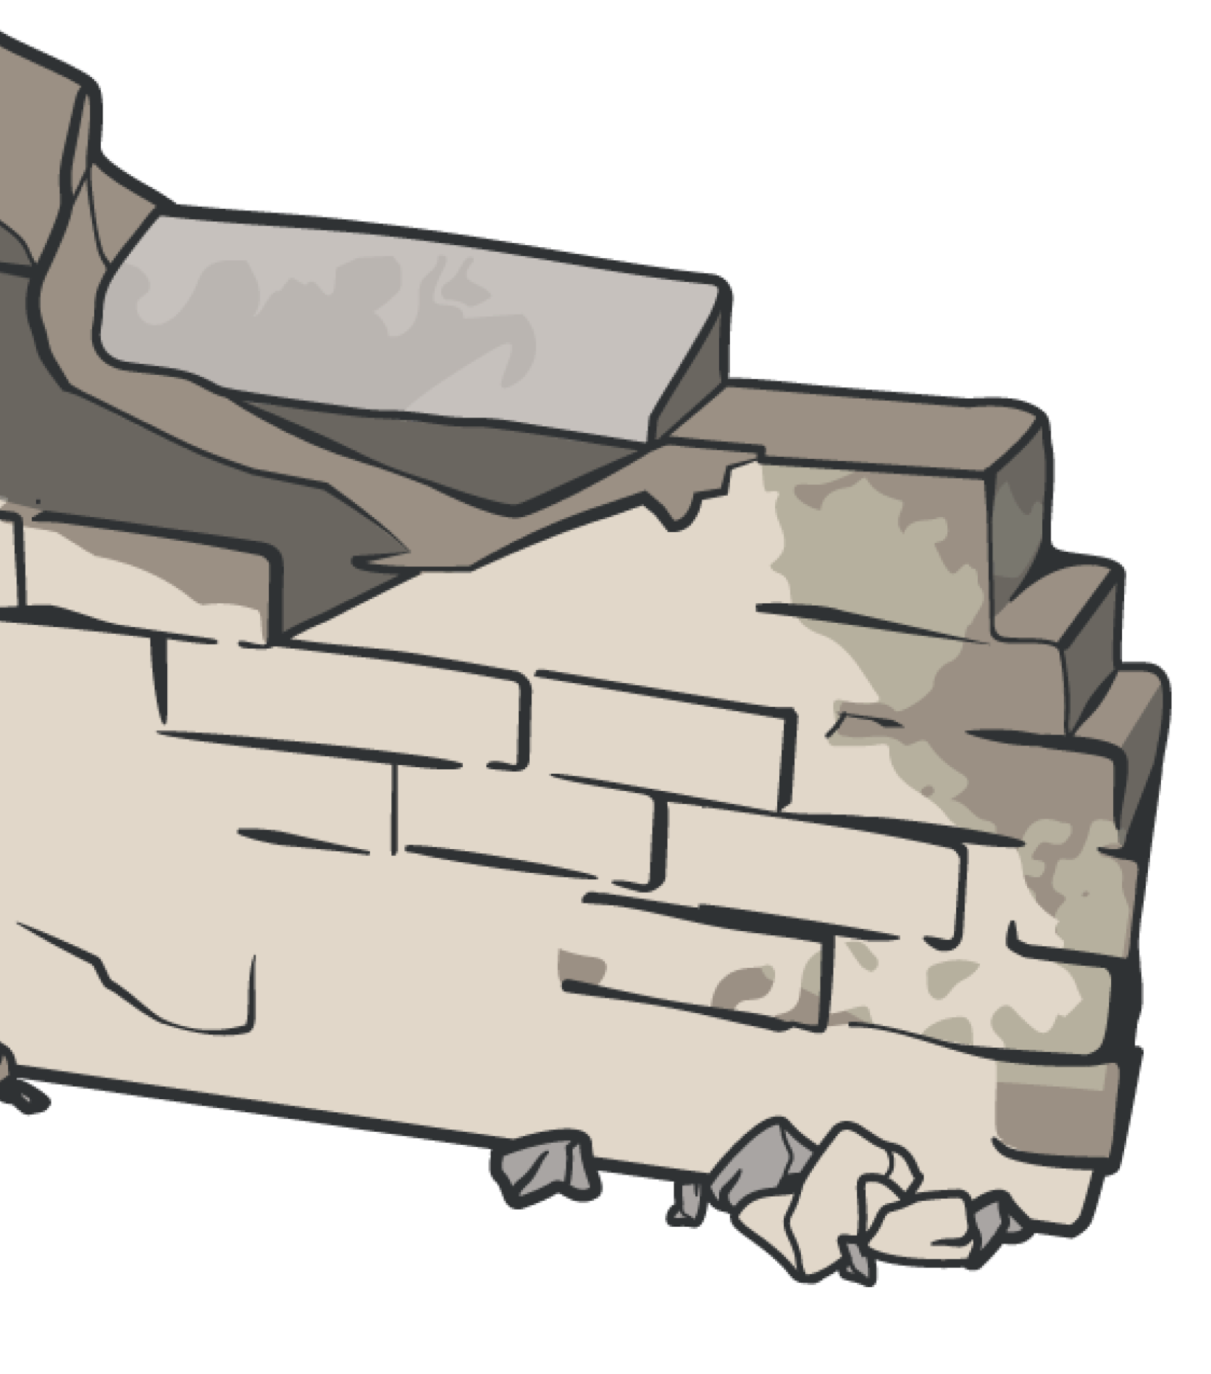
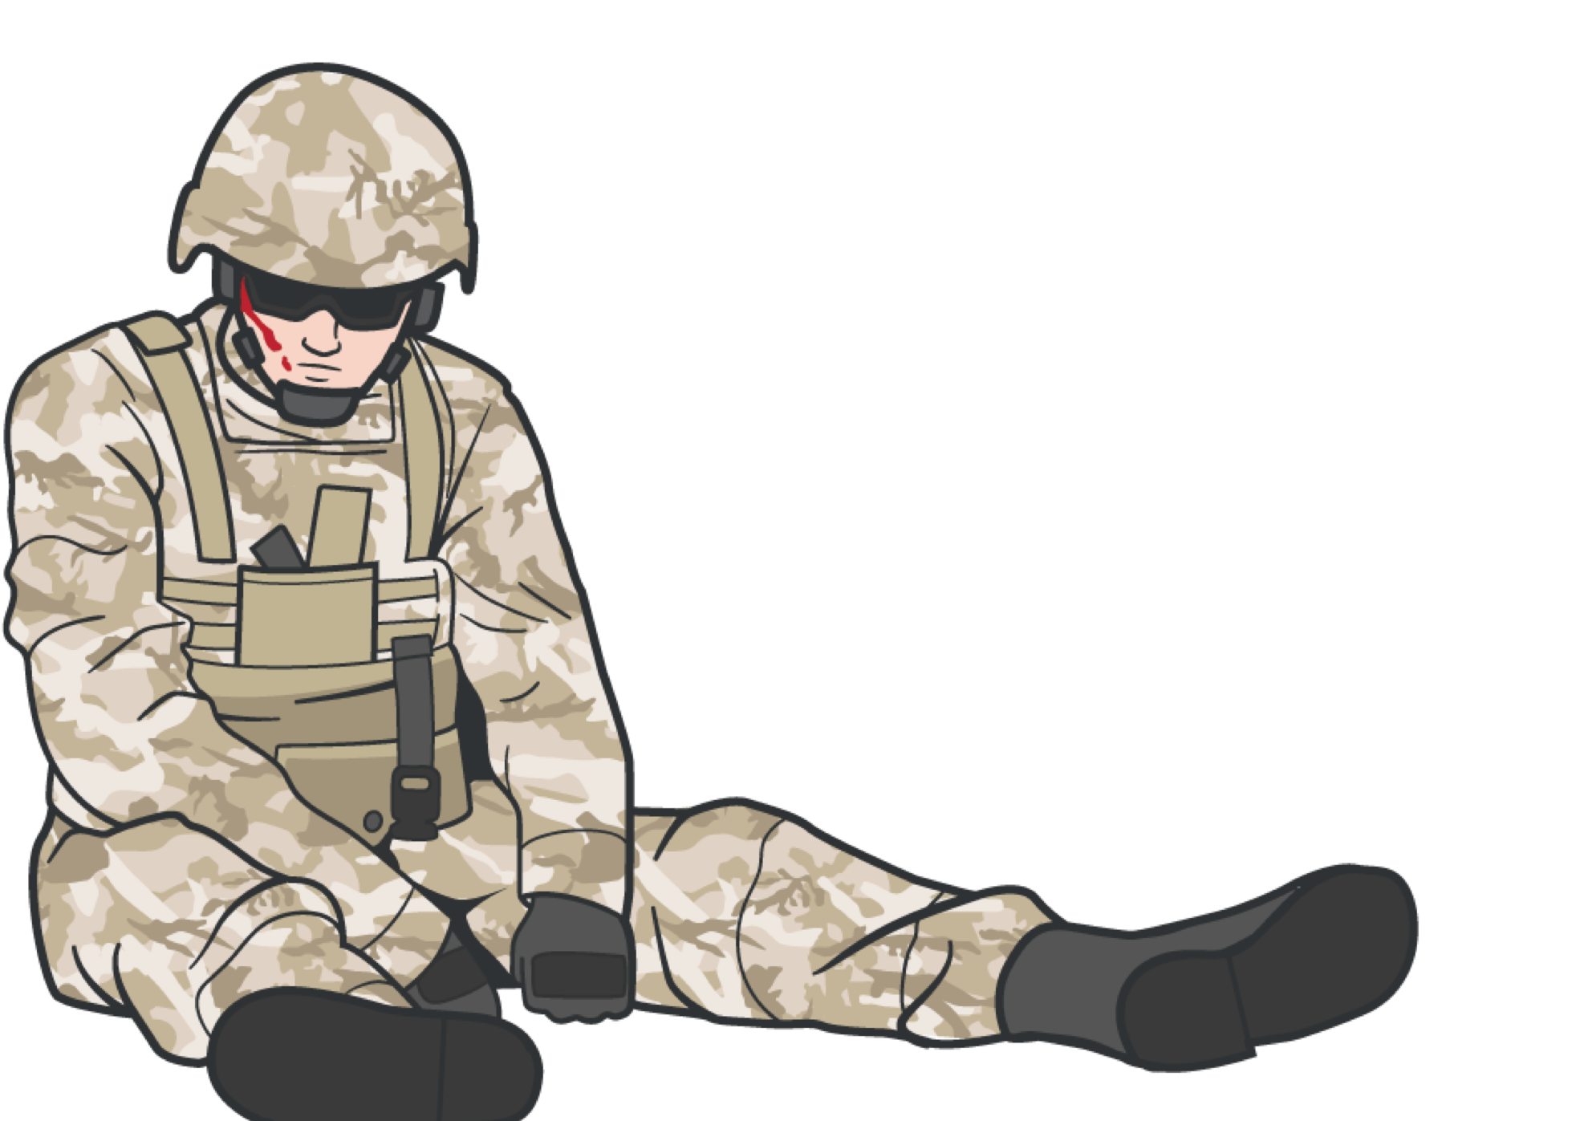

HEAD INJURIES
SUMMARY
We defined head injury
We discussed mechanisms of injury
We discussed signs and symptoms
We identified critical observations to report to higher medical personnel
9

Slide 10

HEAD INJURIES
CHECK ON LEARNING
What external forces can cause a head injury?
What are the critical observations that should be reported to medical personnel for trauma casualties with a suspected head injury, in accordance with MACE 2?
10

Slide 11
HEAD INJURIES
ANY QUESTIONS?
11

